Slide 1


Hormones & Behavior
[Professor Name]
[Class and Section Number]
Notes:
Class Recommendations: This module can be taught in one 90-minute class, or two-shortened 45 minute class periods.
Overview: This module provides an introduction to the role of hormones in behavior, specifically aggression, sex differentiation, and parenting. It also provides examples of research studies illustrating this interaction in humans and animal models.
Technical Note: These slides may contain simple click animation so that you can focus students’ attention on a particular question, a selection of text, or an image and not have them be distracted by reading ahead. You can either preview the sequence of animation by going through the slides in slideshow view, visiting the animations tab, or reviewing the slide notes. In the notes you will see a cue - (Click) – that corresponds to each animation.
You may also find hyperlinks to outside videos at various places in the slides. These hyperlinks are embedded in text and indicated by color and in the notes section.

Slide 2
Learning Objectives
Define the basic terminology and basic principles of hormone–behavior interactions.
Explain the role of hormones in behavioral sex differentiation.
Explain the role of hormones in aggressive behavior.
Explain the role of hormones in parental behavior.
Provide examples of some common hormone–behavior interactions.
Notes:
The purpose of this slide is to outline the learning objectives of the module.

Slide 3
Overview
Hormones as Chemical Messengers
Synthesis
Interacting with Cells
Sex Differentiation
Sexual Dimorphism
Biological Processes
Biology versus Society
Parental Behavior
Maternal versus Paternal care
Hormones and Mothers
Aggressive Behavior
Hormones and Behavior
Notes:
The purpose of this slide is to provide students with an overview of the material that will be covered during the lecture

Slide 4
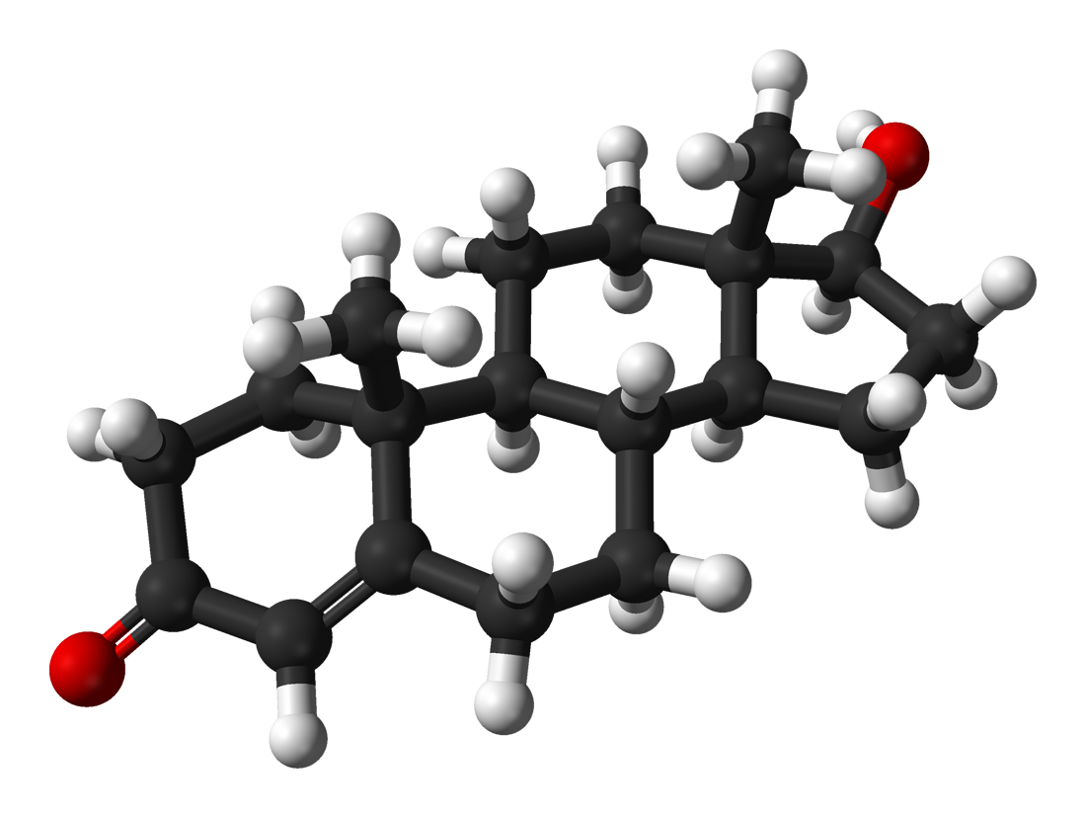
Warm Up Activity
Hormone Quiz
What were your results?
Were you surprised?
How would others would score?
Did you use textbook or other external resource?
Notes:
The purpose of this slide is to facilitate a discussion surrounding students’ results on the quiz they took prior to class.
Ask students to complete the following quiz and print results to bring to class.
Quiz Link:
http://www.funtrivia.com/playquiz/quiz2528371cf2a60.html
(Click): Hormone Quiz
(Click): What were your results?
(Click): How do you think others would score on this quiz?
(Click): Did you use your textbook or any other external resource?
Discuss students’ results and false preconceptions surrounding hormones. Were students surprised by their results? How do they believe others would score on this quiz? Did students reference their textbook or external resources for any answers?

Slide 5
Hormones as Chemical Messengers
Hormones Versus Neurotransmitters
Similarities | Neurotransmitters | Hormones
Chemicals | Travel on existing neural networks | May reach any cell supplied by blood
Mechanism of release from cell | All-or-none | Graded according to concentration of hormone and receptor
Bind to receptor for effect on target cell | Immediate | Minutes to days
 | Small distance- neuron to neuron | Long distance- may travel throughout body
 | Voluntary control | No control
 | Found only in the brain | Can travel anywhere there is a blood flow
Notes:
The purpose of this slide is to illustrate the similarities and differences between hormones and neurotransmitters.
Hormones and neurotransmitters have several similarities because they are both chemical messengers. This means they’re released from the cell in similar ways and bind to receptors on target cells to induce their effect.
Hormones are unique because they are released into the bloodstream and, therefore, may affect any cell supplied by blood. Several factors influence the extent of a hormone’s effect on an organism, including the concentration of the hormone, location and number of receptors, and the presence of certain enzymes. Hormones may travel long distances before reaching their target, and once bound to a receptor, the effect may take minutes to days.

Slide 6
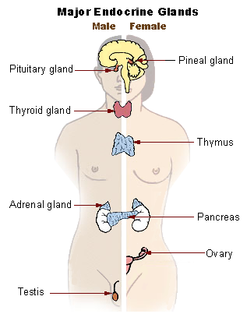
Synthesis
Endocrine glands
Structure
Steroid
Peptide/Protein
Notes:
The purpose of this slide is to provide information about hormone synthesis
(Click): Endocrine glands
Hormones are created in the endocrine glands, which are a series of glands located in the central and peripheral nervous system, including the pituitary gland, adrenal glands, thyroid, pineal gland, and hypothalamus.
(Click): Structure
(Click): Steroid
(Click): Peptide/Protein
Hormones are categorized according to structure, either steroid hormones or peptide/protein hormones.
For more information, see the Hormones and Behavior Module at: http://noba.to/c6gvwu9m

Slide 7
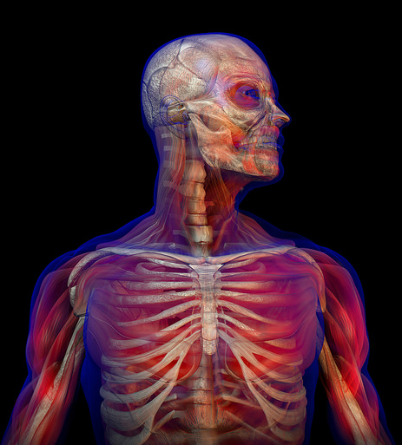
Interacting with Cells
Receptors
Target cells
Gene expression
Functions
Regulate input
Integrate cognition
Control output
Notes:
The purpose of this slide is to provide information about the ways hormones interact with cells to influence behavior.
(Click): Receptors
Hormones interact with cells by binding to receptors, just like neurotransmitters.
(Click): Target cells
Target cells contain receptors for hormones and react when hormones bind.
(Click): Gene expression
This may cause small changes in the physiological processes of the cell, or it may manipulate gene expression. This can cause long-term, cascading effects that allow hormones to affect growth, development, behavior, and other complex processes.
(Click): Functions
Hormones serve many purposes in the body.
(Click): Regulate input
Hormones can influence your senses, making you more or less sensitive to certain stimuli.
(Click): Regulate cognition
They can influence cognition by increasing the speed of transmission or the strength of a pathway.
(Click): Control output
Hormones can also influence your response by their effect on muscles and organ systems.

Slide 8

Interacting with Cells
Not causal, influences probability
Threat, win/loss, sex
Multipurpose
Notes:
The purpose of this slide is to continue providing information about the ways hormones interact with cells to influence behavior.
(Click): Not causal, influences probability
When exposed to a threat, hormones help you react in response to your fight-or-flight instinct.
(Click): Threat, win/loss, sex
Competitors, as well as fans, experience a drop in testosterone after a loss and an increase in testosterone after a win. The anticipation of sex can also cause the release of testosterone, influencing mating and reproductive behaviors.
(Click): Multipurpose
Hormones, like many other biological compounds, have evolved to serve multiple purposes in the body. The hormones testosterone and estradiol are responsible for sperm and egg maturation, and also promote mating behaviors. This increases the likelihood sex will occur and the egg will be fertilized.

Slide 9

Discussion
What are some ways that these hormonally induced cellular changes might theoretically produce profound changes in behavior?
Notes:
The purpose of this slide is to facilitate a discussion on potential behavioral outcomes of hormone-induced cellular changes.
Hormones cause changes in the rates of cellular processes or in cellular morphology.
Ask students: What are some ways that these hormonally induced cellular changes might theoretically produce profound changes in behavior?
Discuss gene expression, cascading events, protein synthesis, changes in brain structure and function, pregnancy, parental behaviors, puberty, aggression, etc.

Slide 10
Overview
Hormones as Chemical Messengers
Synthesis
Interacting with Cells
Sex Differentiation
Sexual Dimorphism
Biological Processes
Biology versus Society
Parental Behavior
Maternal versus Paternal care
Hormones and Mothers
Aggressive Behavior
Hormones and Behavior
Notes:
The purpose of this slide is to provide students with an overview of the material that will be covered during this section of the lecture

Slide 11
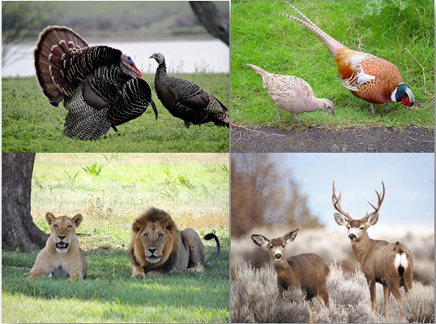
Sex Differentiation
Process of becoming male or female
Notes:
The purpose of this slide is to introduce sexual differentiation.
(Click): Sexual differentiation- process of becoming male or female
Sexual differentiation is the process of becoming male or female. This encompasses all factors influencing development, from fertilization through puberty. These photos illustrate obvious differences between males and females in different animal species, though these differences are not always so clear.

Slide 12
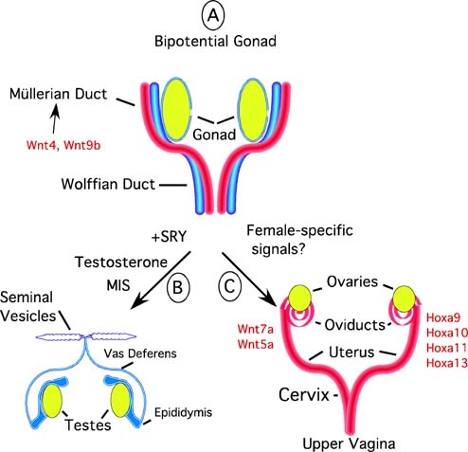
Sexual Dimorphism
Male vs. Female
Masculinization
Feminization
Notes:
The purpose of this slide is to provide information about sexual dimorphism in human and animal species, and the role of hormones in sexual development.
(Click): Male versus Female
Almost all animal species, including humans, have two sexes that display differences physically, mentally, and behaviorally. Hormones are a large factor in these differences observed. Prenatally or shortly after birth, exposure to hormones affects the development of the brain and body to become male or female. Hormones are released again at puberty, which provide for the further development of male or female features.
(Click): Masculinization
Masculinization involves the exposure to androgens early in life and at puberty.
(Click): Feminization
Lack of exposure to androgens results in feminization and the development of a female. This may result from being genetically female, or an error in differentiation preventing masculinization.

Slide 13
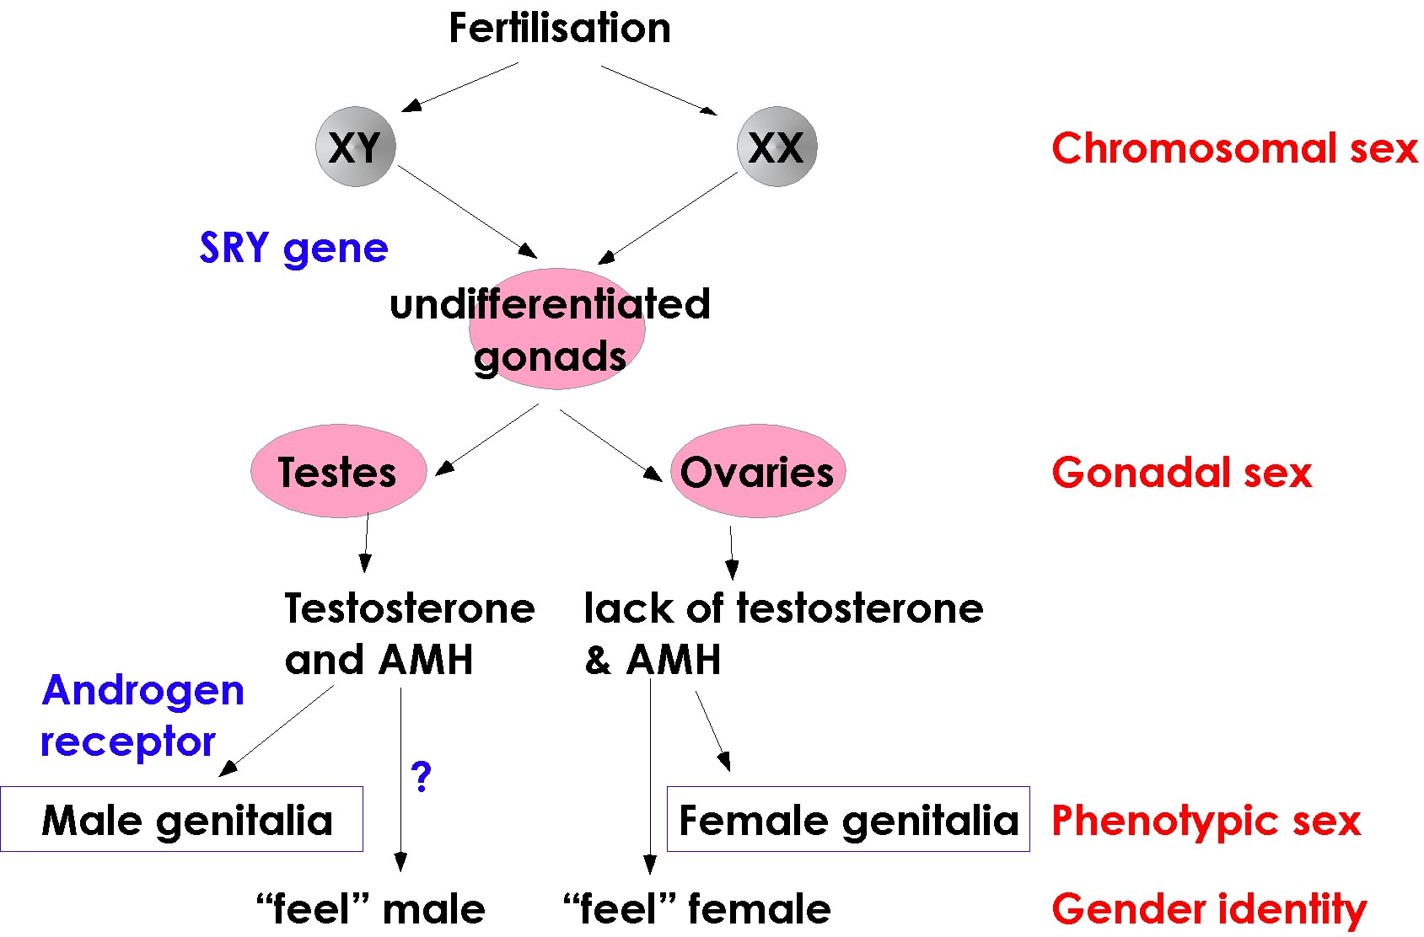
Biological Processes
Notes:
The purpose of this slide is to introduce biological processes that impact the development of one’s sex.
Sexual Differentiation – male vs. female
Sexual differentiation includes all processes that influence the development of one’s sex.
Sex Determination – XX vs. XY
In contrast, sex determination refers to the genetic determination of sex at the time of fertilization, XX or XY. Chromosomal sex does not always correspond with observed sex, as is often the case when there is dysfunction at some point in development.

Slide 14
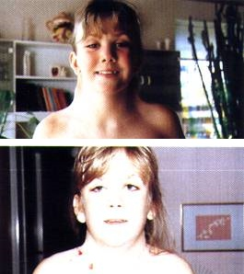
Biological Processes
Dysfunction
Turner Syndrome
5α-reductase deficiency
Androgen insensitivity
Notes:
The purpose of this slide is to illustrate potential issues with sex determination.
(Click): Dysfunction
(Click): Turner Syndrome
Turner syndrome occurs when a female has a damaged or missing second X chromosome. These individuals typically look and act female, though issues with fertility and development are common. The image shows a girl before surgery (top) and after she had neck webbing removed.
(Click): 5α-reductase
5α-reductase deficiency is the lack of an enzyme involved in the development of male genitalia, resulting in female features until puberty when male features develop.
(Click): Androgen insensitivity
Androgen insensitivity occurs when an individual lacks receptors for androgens. Despite being chromosomally male, these individuals develop as female.

Slide 15
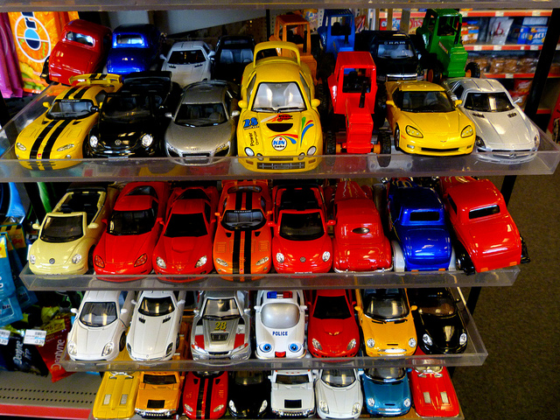
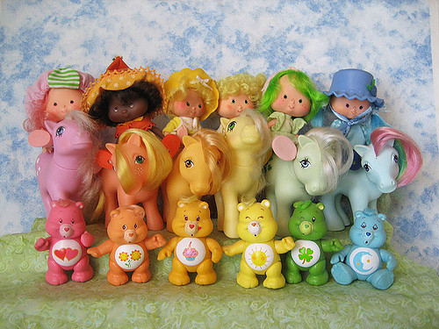
Biology vs Society
Toy preference
Boys versus girls
Vervet and Rhesus monkeys
Play
Notes:
The purpose of this slide is to highlight factors influencing behavioral differences observed between male and female animals and humans.
(Click): Toy preference
Children display a preference for toys according to gender.
(Click): Boys versus girls
This preference may be the result of differences in the wiring of boy and girl brains, such that certain toys are more appealing according to sex. Toy preference could also be the result of environmental pressures from adults and peers to play with toys marketed for their sex.
(Click): Vervet and Rhesus monkeys
This preference has also been observed in primate species. Male Vervet and Rhesus monkeys display a preference for toys according to gender.
(Click): Play
Type of play also differs between sexes. Boys are more likely to engage in rough-and-tumble play than girls, and this is mirrored in the animal kingdom. Parents are more likely to play “rough” with boys than girls. So determining whether biology or society is a greater factor in this difference can be a challenge.

Slide 16

CAT: The Muddiest Point
What was the muddiest point in today’s class?
Write down what concept you are still struggling to understand.
Notes:
Classroom Assessment Technique (CAT): The Muddiest Point
Ask students to write down the “muddiest point” – that is any concept they are still struggling to understand of any questions they still may have about the material. With remaining class time, ask students to share their muddiest point and provide additional review on these points.
If you do not conclude with this Classroom Assessment Technique (CAT), it would helpful to use another CAT. It could be in the form of a:
Muddy point
One-minute paper
Background knowledge
What’s the Principle?
Defining features Matrix:
For more information on CATs click here: http://cft.vanderbilt.edu/guides-sub-pages/cats/

Slide 17
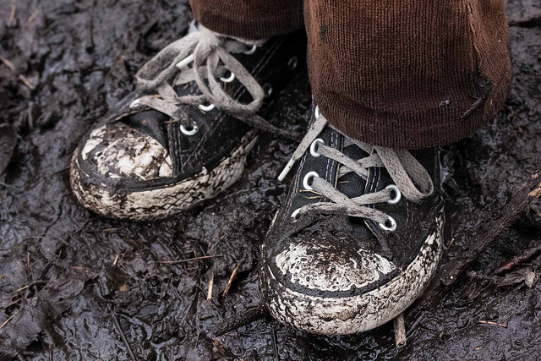
Warm Up Activity
Review- Revisiting the Muddy Points
Topics of Concern
Questions?
Notes:
The purpose of this slide is to review areas of concern identified during the CAT, The Muddiest Point.
This slide may serve as the start of day two’s lecture, or the first slide after a short break if a single lecture is being taught.
After going through students’ responses to, “The Muddiest Point” activity, review topics of concern and answer any questions from students.

Slide 18
Overview
Hormones as Chemical Messengers
Synthesis
Interacting with Cells
Sex Differentiation
Sexual Dimorphism
Biological Processes
Biology versus Society
Parental Behavior
Maternal versus Paternal care
Hormones and Mothers
Aggressive Behavior
Hormones and Behavior
Notes:
The purpose of this slide is to provide students with an overview of the material that will be covered during this section of the lecture

Slide 19
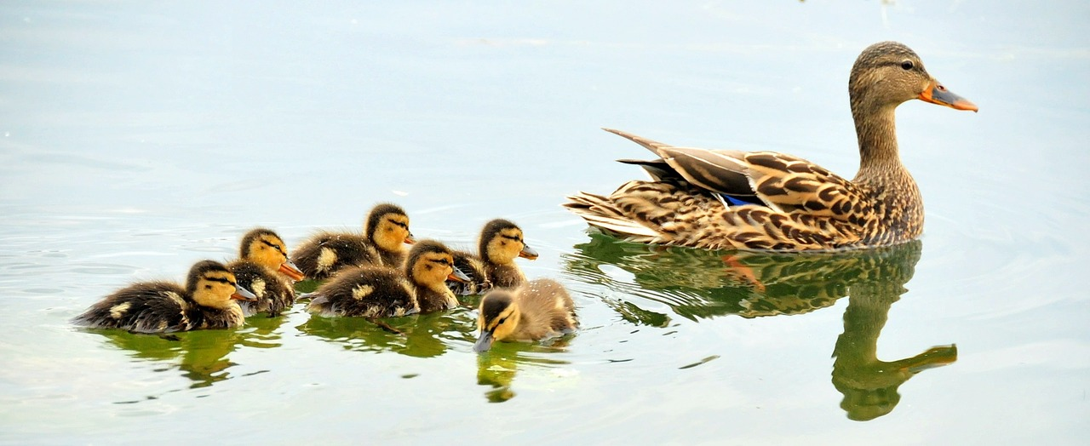
Activity
Notes:
The purpose of this slide is to introduce and complete the activity, “The Mating Game”
The Mating Game
Web Materials:
Go to this website to get the PDF with full instructions: http://abt.ucpress.edu/content/74/9/648.full.pdf+html
Or get the full page PDF here: http://abt.ucpress.edu/content/ucpabt/74/9/648.full.pdf
Here is a link to all the supplemental materials like the Excel spreadsheet for the instructor and gametes sheets: https://sites.google.com/site/theclassroommatinggame/
Other Materials:
Student instructions document, “Gametes” slides, class worksheet, instructor spreadsheet, 1” strips of colored paper and paper clips for “headbands”
Directions:
*DO NOT hint to students that this activity will happen, the element of surprise is needed for the discussion.
1. Print “Gametes” slides (one copy for every 18 students in class) and student instructions document (one for each student). Distribute instructions to students. Separate slides containing gametes (slides 2-10, and 12-20) and pass out randomly to class. Gametes should be distributed without regard to the students’ gender, such that some men will receive eggs and some women will receive sperm. Designate a headband color for male or female and distribute to indicate students’ assigned sex. Students should color big dots on their headband to correspond with their “quality score” (1-5), the number found on each gamete, so that their score is easily visible to other students.
2. When everyone is ready, instruct students to mingle in a designated “breeding area.” During this time, students should find a mate of the opposite sex to pair gametes. Once a male and female agree to “mate”, the female must bring the pair to the instructor, located outside the “breeding area”, who will use the excel spreadsheet provided to record the identification number and quality score from each gamete in the pair. This information is used to determine the “reproductive success” of each student during one mating season. After all females have run out of gametes, breeding season is over (about 5 minutes).
3. The excel spreadsheet provided allows the instructor to enter data as pairs are made, and calculations are automatically made with this information. This spreadsheet also automatically generates four plots showing the number of matings and total reproductive success points, separated by sex.
4. Ask: Did you feel any sort of stress response when this activity was first described? What physical symptoms did you experience? What other times in your life have you felt these symptoms? Discuss the role of hormones in the stress response.
5. Ask: Did you notice any change in behavior by either sexes when “breeding season” began? Were any of these behaviors unique to one sex? How do you think stress impacted your behavior during the beginning, middle, and end of the breeding season? Discuss how stress may influence behavior.
6. At this time, introduce the concept of parental investment, operational sex ratio, and sex roles.
Parental investment- time and resources each parent invests in offspring. This correlates to the number of offspring with each pregnancy and time spent rearing.
Operational sex ratio- ratio of each sex available to mate. This correlates to how selective one sex can be (e.g. more females= males can be selective, more males= females can be selective).
Sex roles- impact of each sex’s role in parenting on selectivity during mating. This also correlates to the degree of selectivity of each gender.
7. As a class, complete the conceptual flowchart titled “Class Worksheet” to illustrate the relationship between mating and parenting behaviors. Discuss how hormones like testosterone and oxytocin are involved in these behaviors

Slide 20

Parental Behavior
Any behavior that contributes to the survival of a fertilized egg or offspring.
Notes:
The purpose of this slide is to define parental behavior
Parental behavior refers to any behavior that contributes to the survival of a fertilized egg or the resulting offspring.

Slide 21
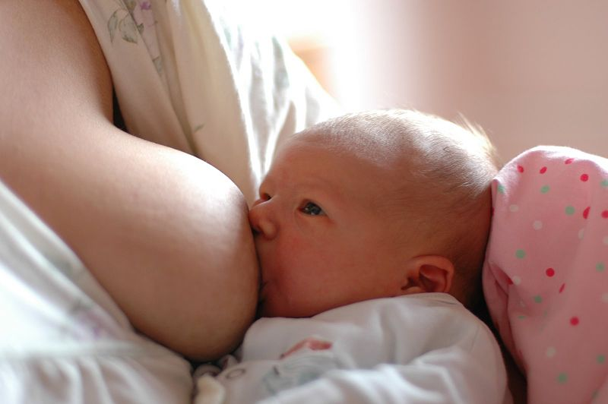
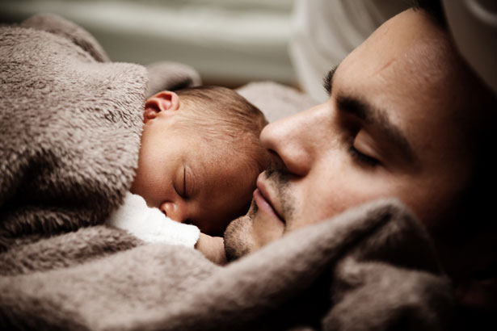
Maternal versus Paternal Care
Maternal care more common
Rats
Mating
Notes:
The purpose of this slide is to review differences in maternal and paternal care in human and animal species.
(Click): Maternal care more common
Maternal and paternal care differs greatly, and maternal care is much more common.
(Click): Rats
Mother rats display stereotypical maternal behaviors toward their pups. In order to properly care for their offspring, mother rats experience a decrease in avoidance and an increase in approach behaviors. Non-mother females and males behave very differently, displaying neophobia, or fear of the pups. Extended exposure to pups can cause a sensitization, such that non-mothers and males will get used to the pups and provide maternal care.
(Click): Mating
Hormones are also involved in the mating process. Testosterone is responsible for birds singing to attract mates and mating displays common among birds and many other animals. Hormones are also responsible for reproductive and fertility cycles.

Slide 22
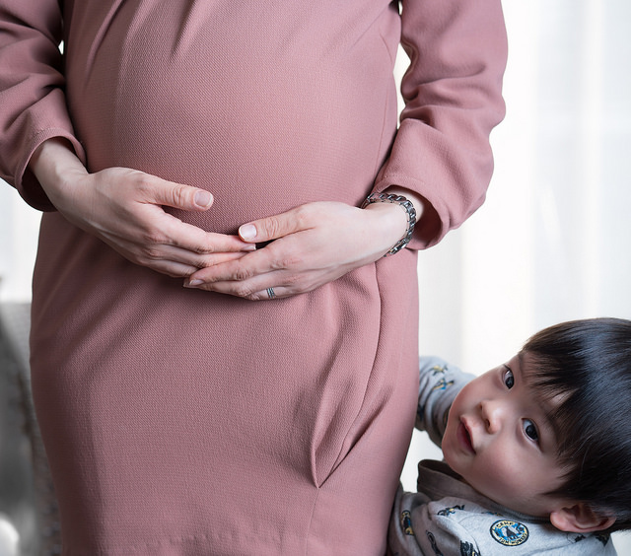
Hormones and Mothers
Pregnancy
Maternal instinct
Maternal aggression
Notes:
The purpose of this slide is to provide information regarding the role of hormones in motherhood.
(Click): Pregnancy
Pregnancy brings many hormonal changes in the mother-to-be and is responsible for transforming the mother’s body in a healthy way. Levels of hormones like estrogen, progesterone, and prolactin increase continuously throughout the pregnancy and continue fluctuating after the baby is born.
(Click): Maternal instinct
Maternal instinct is a wonderful example of hormones affecting behavior. Hearing a crying baby can prompt an expecting or new mother to begin lactating without the presence of their child. Mothers also experience an increase in auditory sensitivity to the sound of crying, so they can be more responsive even when asleep. The role of hormones in maternal instinct are believed to include the drop in progesterone after giving birth in combination with an increase in estradiol, prolactin, and oxytocin. Cortisol is also believed to be associated with certain maternal instincts.
(Click): Maternal aggression
Maternal aggression in rodents is believed to be mediated by progesterone.

Slide 23
Overview
Hormones as Chemical Messengers
Synthesis
Interacting with Cells
Sex Differentiation
Sexual Dimorphism
Biological Processes
Biology versus Society
Parental Behavior
Maternal versus Paternal care
Hormones and Mothers
Aggressive Behavior
Hormones and Behavior
Notes:
The purpose of this slide is to provide students with an overview of the material that will be covered during this section of the lecture

Slide 24
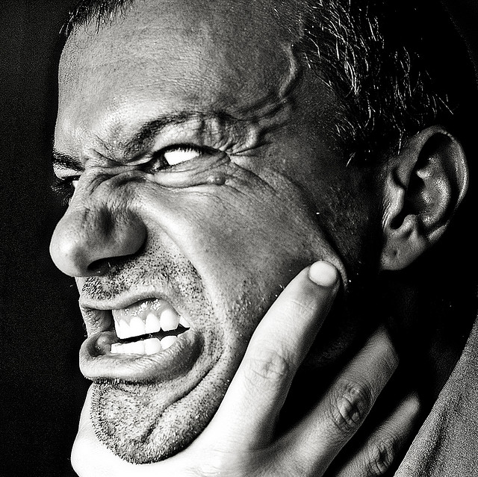
Aggressive Behavior
Limited resources
Androgens
Research study
Castration
Testosterone
Notes:
The purpose of this slide is to provide an overview of the role of hormones in aggressive behavior.
(Click): Limited resources
Aggressive behavior usually occurs as the result of two or more organisms having a conflict of interest, typically in response to limited resources.
(Click): Androgens
Androgens play a large role in an aggressive response to a social interaction. Plasma testosterone levels have been correlated with amount of aggressive behavior in rats. The increase in aggression during and after puberty is associated with the increase in circulating androgens. Males of many species tend to be the more aggressive gender, and testosterone levels, as well as aggressive behavior, decreases after castration.
(Click): Research Study
A research study performed with mice illustrates the complex interaction between hormones, development, and behavior.
(Click): Castration
Male and female mice were castrated prior to their 6th day of life.
(Click): Testosterone
When these mice are exposed to testosterone as adults, no increase in aggression is observed. If the castrated mice are administered testosterone after castration, but still before day 6, these mice will respond to testosterone exposure as adults and an increase in aggression is observed.

Slide 25
Overview
Hormones as Chemical Messengers
Synthesis
Interacting with Cells
Sex Differentiation
Sexual Dimorphism
Biological Processes
Biology versus Society
Aggressive Behavior
Androgens
Research Studies
Parental Behavior
Maternal versus Paternal care
Hormones and Mothers
Hormones and Behavior
Notes:
The purpose of this slide is to provide students with an overview of the material that will be covered during this section of the lecture

Slide 26
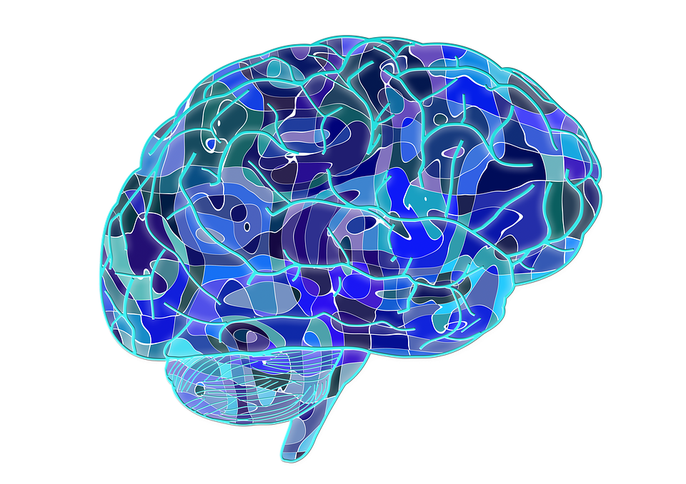
Hormones and Behavior
Food and fluid intake
Social interactions
Salt balance
Learning and memory
Stress and coping
Psychopathologies- depression, anxiety, eating disorders, postpartum and seasonal depression
Notes:
The purpose of this slide is to provide an overview of other behaviors influenced by hormones.
In addition to sexual differentiation, aggression, and parental care, hormones are involved in many other biological and psychological processes.
Additional research is needed to determine what mediates these interactions and how dysfunction in these systems can be treated.
(Click): Food and fluid intake
(Click): Social interactions
(Click): Salt balance
(Click): Learning and memory
(Click): Stress and coping
(Click): Psychopathologies- depression, anxiety, eating disorders, postpartum and seasonal depression

Slide 27

Video
Your Body During Sex
Notes:
The purpose of this slide is to link to a YouTube video.
Your Body During Sex
This video discusses the biological changes experiences during intercourse, including the role of hormones and neurotransmitters.
https://www.youtube.com/watch?v=mWWl6L1QeO8
After the video, briefly review the role of hormones in sexual arousal and mating.
For more information please refer to the Hormones and Behavior Module http://noba.to/c6gvwu9m

Slide 28
CAT: Analytic Memos
A new bill is being proposed that would make gender identification on legal documents restricted to whether an individual is genetically XX or XY.
Write a letter to a representative explaining the issue with this bill and the biology responsible for gender development.
Notes:
CAT: Analytic Memos
Instruct students to write a one to two page response to the following issue:
A new bill is being proposed that would make gender identification on legal documents restricted to whether an individual is genetically XX or XY. Write a letter to a representative explaining the issue with this bill and the biology responsible for gender development.
Students may write this at home and turn in before next class period for credit. Responses should discuss chromosomal sexes in addition to typical XX and XY, such as XXY, XYY, XO, as well as the difference between sex and gender and the role of hormones in the development of one’s gender.
If you do not conclude with this Classroom Assessment Technique (CAT), it would helpful to use another CAT. It could be in the form of a:
Muddy point
One-minute paper
Background knowledge
What’s the Principle?
Defining features Matrix:
For more information on CATs click here: http://cft.vanderbilt.edu/guides-sub-pages/cats/

Slide 29
Photo Attribution
Slide 1 | Photo Credit: Whitehead-link-alternative-sexuality-symbol AnonMoos https://en.wikipedia.org/wiki/Sex_differences_in_psychology#/media/File:Whitehead-link-alternative-sexuality-symbol.svg Public Domain
Slide 4 | Photo Credit: Ball-and-stick model of the testosterone molecule Ben Mills https://en.wikipedia.org/wiki/Testosterone#/media/File:Testosterone-from-xtal-3D-balls.png Public Domain
Slide 6 | Photo Credit: Location of major endocrine glands US Government https://en.wikipedia.org/wiki/Endocrine_system#/media/File:Illu_endocrine_system_New.png Public Domain
Slide 7 | Photo Credit: 82217752 Lwp Kommunikáció https://www.flickr.com/photos/55269648@N04/23976653643/ https://creativecommons.org/licenses/by/2.0/
Slide 8 | Photo Credit: Germany lifting the World Cup trophy in 2014 Marcello Casal Jr/Agência Brasil https://en.wikipedia.org/wiki/Germany_national_football_team#/media/File:Germany_lifts_the_2014_FIFA_World_Cup.jpg http://creativecommons.org/licenses/by/3.0/br/deed.en
Slide 9 | Photo Credit: Questions1 Grisel D´An https://www.flickr.com/photos/128454566@N06/15893429463 https://creativecommons.org/licenses/by-nc/2.0/
Slide 11 | Photo Credit: pair-of-wild-turkey-birds-male-and-female-in-breeding-plumage-meleagris-gallopavo Burton Robert, U.S. Fish and Wildlife Service http://www.public-domain-image.com/free-images/fauna-animals/birds/turkey-birds-pictures/pair-of-wild-turkey-birds-male-and-female-in-breeding-plumage-meleagris-gallopavo/attachment/pair-of-wild-turkey-birds-male-and-female-in-breeding-plumage-meleagris-gallopavo Public Domain Photo Credit: Male and female pheasant ChrisO https://commons.wikimedia.org/wiki/File:Male_and_female_pheasant.jpg#/media/File:Male_and_female_pheasant.jpg https://creativecommons.org/licenses/by-sa/3.0/ Photo Credit: Lions davidsluka https://pixabay.com/en/lions-animal-male-female-lions-175934/ https://creativecommons.org/publicdomain/zero/1.0/deed.en Photo Credit: Rocky Mountain mule deer doe and buck California Department of Fish and Wildlife https://www.flickr.com/photos/californiadfg/20471585031 https://creativecommons.org/licenses/by/2.0/
Notes:
Photo Attribution Slide

Slide 30
Photo Attribution
Slide 12 | Photo Credit: The uterus differentiates from the fetal Müllerian ducts Teixeira, J., Rueda, B.R., and Pru, J.K., Uterine Stem cells (September 30, 2008), StemBook, ed. https://commons.wikimedia.org/wiki/File:The_uterus_differentiates_from_the_fetal_M%C3%BCllerian_ducts..jpg#/media/File:The_uterus_differentiates_from_the_fetal_M%C3%BCllerian_ducts..jpg https://creativecommons.org/licenses/by/3.0/
Slide 13 | Photo Credit: Schematic of sexual differentiation in humans Syko lozz https://commons.wikimedia.org/wiki/File:Sex-diff.jpg#/media/File:Sex-diff.jpg Public Domain
Slide 14 | Photo Credit: Girl with Turner syndrome before and immediately after her operation for neck-webbing Johannes Nielsen https://commons.wikimedia.org/wiki/File:Neck_of_girl_with_Turner_Syndrome_(before_and_after).jpg#/media/File:Neck_of_girl_with_Turner_Syndrome_(before_and_after).jpg https://creativecommons.org/licenses/by/2.0/
Slide 15 | Photo Credit: Toy Cars Rusty Clark - On the Air M-F 8am-noon https://www.flickr.com/photos/rusty_clark/9425014496 https://creativecommons.org/licenses/by/2.0/ Photo Credit: rainbow of 80s toys Aimee Ray https://www.flickr.com/photos/merwing/2152164258/ https://creativecommons.org/licenses/by-nc-nd/2.0/
Slides 16 & 28 | Photo Credit: Illustrated silhouette of a black cat nehtaeh79 http://www.freestockphotos.biz/stockphoto/16624 http://creativecommons.org/publicdomain/zero/1.0/
Slide 17 | Photo Credit: Muddy Black Converse Sneakers Corduroy Pants Muddy Hike Hodenpyl Woods Park EGR April 28, 2013 15 Steven Depolo https://www.flickr.com/photos/stevendepolo/9333752335 https://creativecommons.org/licenses/by/2.0/
Slide 19 | Photo Credit: Mallard Ducks skeeze https://pixabay.com/en/mallard-ducks-hen-brood-waterfowl-934518/ https://creativecommons.org/publicdomain/zero/1.0/deed.en
Notes:
Photo Attribution Slide

Slide 31
Photo Attribution
Slide 20 | Photo Credit: Family Code Martin, USCDCP http://www.public-domain-image.com/free-images/people/family-participation-washing-their-labrador-retrieve Public Domain
Slide 21 | Photo Credit: Breastfeeding the baby. Anton Nossik https://commons.wikimedia.org/wiki/File:Breastfeeding_a_baby.JPG#/media/File:Breastfeeding_a_baby.JPG https://creativecommons.org/licenses/by/3.0/ Photo Credit: Baby And Dad Sleeping Vera Kratochvil http://www.publicdomainpictures.net/view-image.php?image=16861 https://creativecommons.org/publicdomain/zero/1.0/
Slide 22 | Photo Credit: Takuma is ready to be a big brother Big Ben in Japan https://www.flickr.com/photos/74418647@N00/25127318119/ https://creativecommons.org/licenses/by-sa/2.0/
Slide 24 | Photo Credit: Violence! [Explored] Riccardo Cuppini https://www.flickr.com/photos/cuppini/3234012812 https://creativecommons.org/licenses/by-nc-nd/2.0/
Slide 26 | Photo Credit: Brain geralt https://pixabay.com/en/brain-biology-abstract-cerebrum-951874/ https://creativecommons.org/publicdomain/zero/1.0/deed.en
Slide 27 | Photo Credit: Couple in Love waldryano https://pixabay.com/en/couple-in-love-passion-shadow-1115986/ https://creativecommons.org/publicdomain/zero/1.0/deed.en
Notes:
Photo Attribution Slide

